Slide 1
11945 - Treasure Hunting

Slide 2
Description
Niflheimr is playing Minecraft recently.
He occupies a lot of towns.
There are many diamonds inside some of those towns.
Whenever he runs out of diamond, he has to figure out the nearest town with diamonds from his current location.

Slide 3
Description
Doing this task every time wastes a lot of time. He asks you to help him for the calculation.
For every town, find the shortest distance to get diamonds from a nearby town which has diamonds.
If the town itself has diamonds, the distance would be 0.
Hint: Use BFS (Breadth First Search) and std::queue.

Slide 4
Input
First line of input contains three integers N, M, K
N: the number of towns
M: the amount of roads between towns
K: the number of towns which has diamond
All the towns are numbered from 1 to N.

Slide 5
Input
For the next M lines, each of them contains two integers a, b, meaning there is a road between a (town) and b (town).
All the roads are bidirectional, and the length of these roads are all 1.
The last line of input contains K distinct integers, denoting the towns which have diamonds.

Slide 6
Output
Output consists of N lines.
For i-th line, output the shortest distance Niflheimr has to travel from town i to get a diamond.

Slide 7
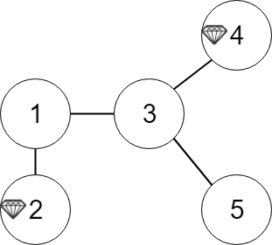
Run example
If the input is:
5 4 2 <- - # of towns, # of roads, # of diamond towns
1 2
1 3
3 4
3 5
2 4 <- - diamond towns
The graph should be
<--roads

Slide 8
Run example
Calculate the shortest distance …..
So the output will be
1
0
1
0
2
0
1
1
2
0

Slide 9
Data Structures
vector<int> diamondTowns; /* the IDs of the diamond towns */
vector<int> G[100005]; /* G[i] is a vector containing all neighbor towns of town i */
int Dist[100005]; /* Dist[i] means the shortest distance to get diamond from town i */
struct node {
int id;
int dist;
node(int id, int l) {
this->id = id;
this->dist = l;
}
};

Slide 10
Program Structure (in main)
int N, M, K;
cin >> N >> M >> K;
for (int i = 0; i < M; i++) {
int a, b;
cin >> a >> b;
G[a].push_back(b);
G[b].push_back(a);
}
for (int i = 0; i < K; i++) {
int x;
cin >> x;
diamondTowns.push_back(x);
}
fill(Dist, Dist+100005, -1);
queue<node> Q;
// [TODO] complete the task!
// Output
for (int i = 1; i <= N; i++) {
cout << Dist[i] << '\n';
}
return 0;
Read
Data
&
Initialize
← Assigns val to all the elements in the range [first,last).

Slide 11
Hint & Concept
How can we know the shortest distance to get diamond starting from a specific town?
-> ask neighbors from the closest to the farthest
This goal can be achieved by BFS (Breadth-First Search)

Slide 12
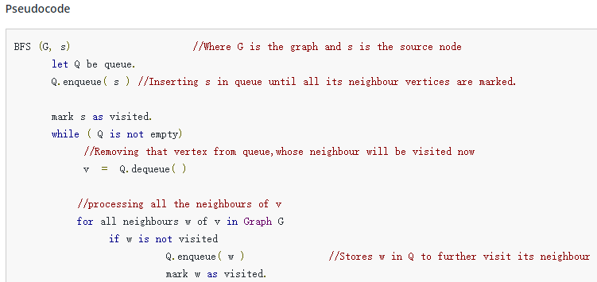
BFS
When s is a
References:
https://www.hackerearth.com/practice/algorithms/graphs/breadth-first-search/tutorial/
http://alrightchiu.github.io/SecondRound/graph-breadth-first-searchbfsguang-du-you-xian-sou-xun.html

Slide 13
Hint & Concept
We can then, for each of the N towns, use the BFS to visit the corresponding tree “level by level” until we get the short-distance diamond town.
However, it will be too slow to find the shortest distances one by one!
-> Why not start from the diamond towns

Slide 14

Hint & Concept
Queue
…
2
5
Virtual root
Level -1
2
5
Level 0
- Diamond towns
1
3
4
3
6
Level 1
…
Has been visited
…

Slide 15
queue<node> Q;
// [TODO] complete the task!
for (auto i: diamondTowns) {
Q.push(node(i, 0)); /* These towns have diamond and are at level 0 */
}
//NOTE: The enqueue operation is slightly different from the above pseudocode, but achieves the same goal.
while (!Q.empty()) {
node cur = Q.front(); Q.pop(); /* get the queue’s top */
if (Dist[cur.id] == -1) { /* not visited */
Dist[cur.id] = cur.dist; /* update distance */
for (auto i: G[cur.id]) { /* push all the neighbors to the queue */
Q.push(node(i, cur.dist+1));
}
}
}

